Slide 1
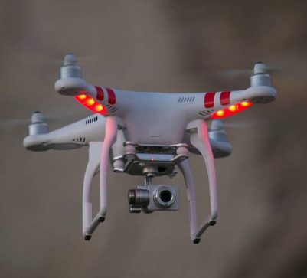

Department of Mechanical
Engineering
IIT Jodhpur
BTP - Evaluation
~22 Nov, 2023
Control of an Amphibious Drone
By:- Nilesh(B20ME050)
Abhishek Kumar(B20ME003)
Supervisor:-
Dr. Jayant Kumar Mohanta

Slide 2
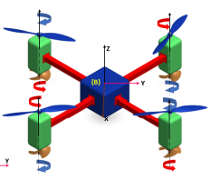
Objective & Motivation
1
2
Attitude and Altitude control of Amphibious Drone
Using controllers like PID, SMC and Fuzzy Logic SMC to get desired Roll, Pitch, Yaw & Height
8-shape trajectory
Physical Simulations
Defense and Security: Hybrid UAUVs can be employed for defense and security purposes, offering versatile surveillance capabilities in both aerial and water.
Oil and Gas Industry: In the oil and gas sector, hybrid UAUVs can be used for inspecting underwater infrastructure, pipelines, and rigs.

Slide 3
Hybrid UAUV’s
An Amphibious Drone, is a type of hybrid Unmanned Aerial and Underwater Vehicle or UAUV that is
characterized by its eight rotors. UAUV vehicles are capable of operating both in the air and underwater
Some key features of UAUV include: -
Versatility: This flexibility could be advantageous for missions that require both aerial and underwater data collection or surveillance.
Adaptive Propulsion Systems: Hybrid vehicles often have specialized propulsion systems to operate efficiently in both air and water.
Seamless Transition: The ability to transition smoothly between aerial and underwater modes is crucial. This would likely involve advanced control systems, sensor integration, and reliable mechanisms for changing modes.
Communication Systems: Effective communication systems would be necessary for the UAUV to relay data between aerial and underwater modes and communicate with a remote operator or control center.
Energy Management: Managing energy efficiently is crucial for a hybrid UAUV, considering the different energy requirements for aerial and underwater propulsion. This might involve advanced battery systems or other power sources.

Slide 4
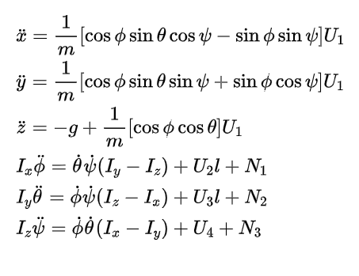
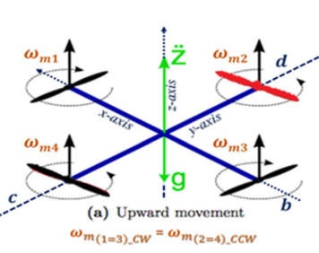
Drone’s Dynamic Model
Dynamic Equations for UAV
We are using plus configuration of Quadrotor.
U_{i} - Thrust on propellers
Φ - Roll - x axis
𝛳 - Pitch - y axis
𝚿 - Yaw - z axis

Slide 5
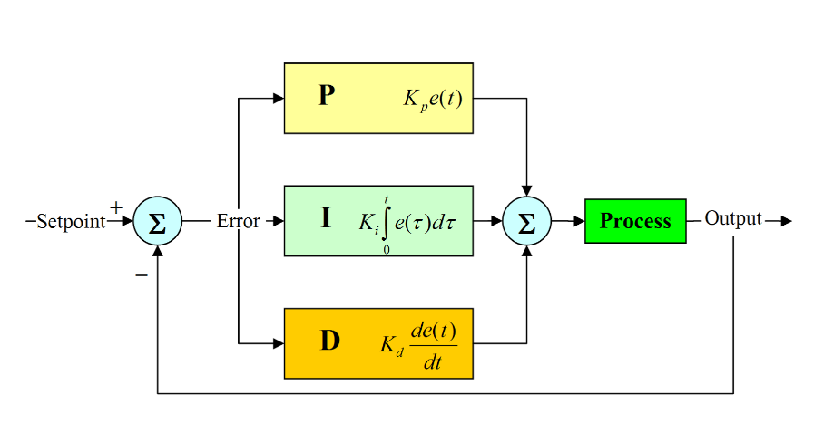
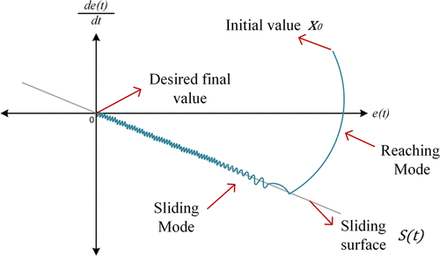
Controllers Used
PID: PID controller is a widely used control mechanism that ensures stable and precise flight. It continuously monitors the drone's orientation and position, comparing them to desired setpoints, and adjusts the motor speeds accordingly. The three constants of the PID controller—proportional (P), integral (I), and derivative (D)—play distinct roles in shaping the controller's behavior.
PID Controller
Sliding Mode Controller:Sliding mode control is a robust nonlinear control technique that can handle uncertainties and disturbances in the system. It maintains stability and performance in uncertain environments, making it valuable for control applications.
Fuzzy Logic Controller:Fuzzy Logic Controller (FLC) is a rule-based control system that uses linguistic variables and fuzzy rules to make decisions, offering adaptability and effective handling of imprecise information in various applications.
SMC Controller

Slide 6
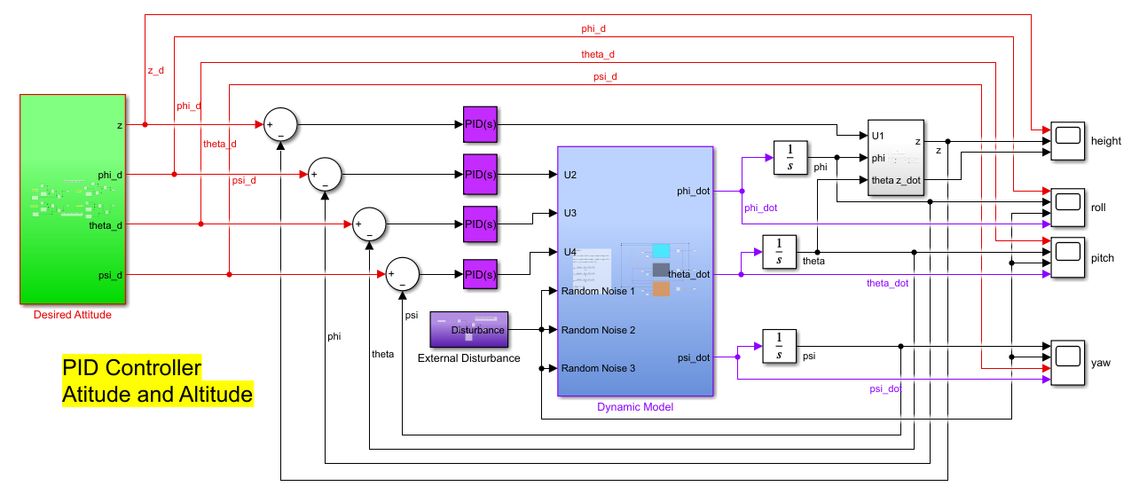
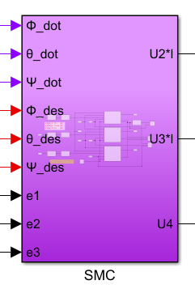
Simulink Model

Slide 7
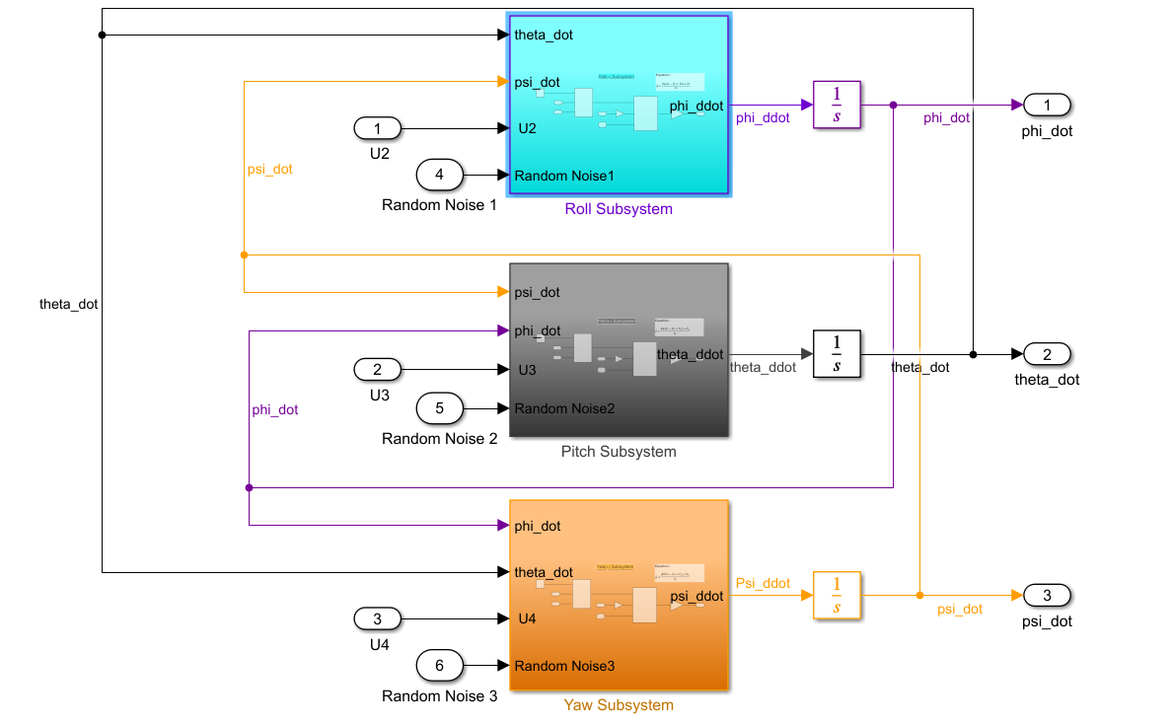
Drone’s Dynamic Model

Slide 8
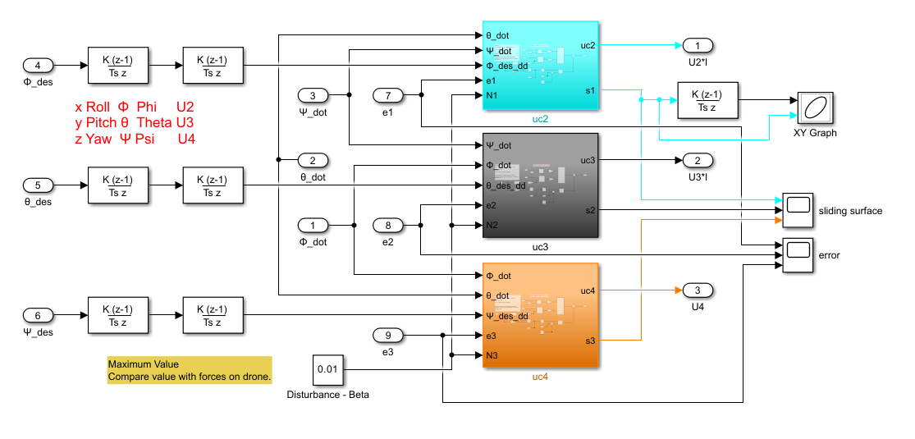
Controllers - SMC & FLSMC

Slide 9
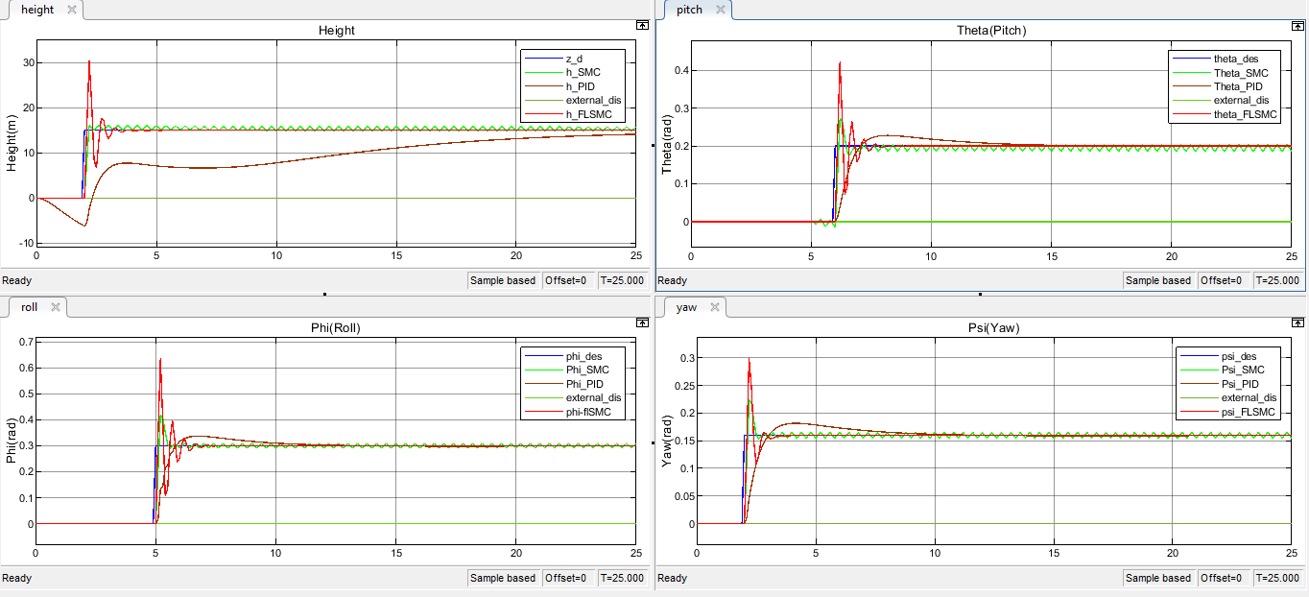
Results(Simulink)
Without Disturbance
Altitude
Roll - Φ
Pitch - 𝛳
Yaw - 𝚿

Slide 10
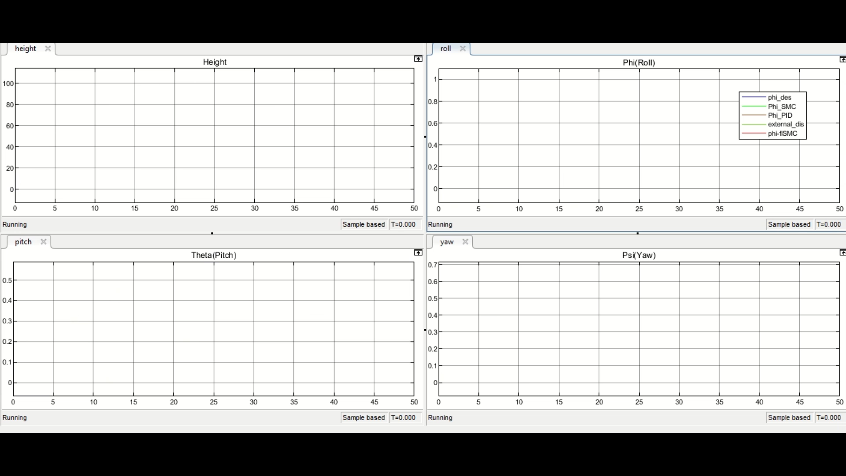
With Disturbance

Slide 11
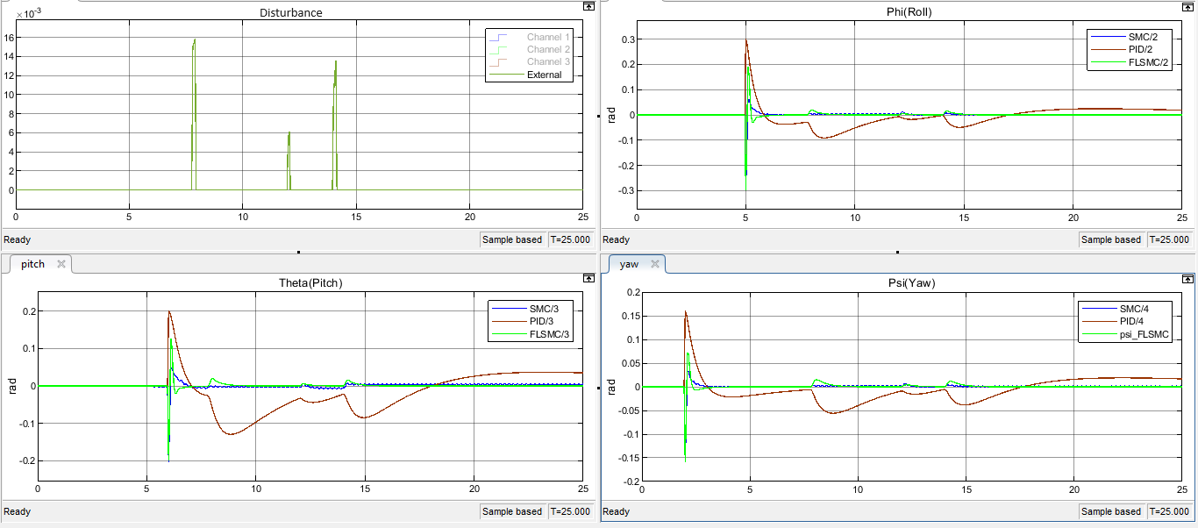
Error Plot

Slide 12
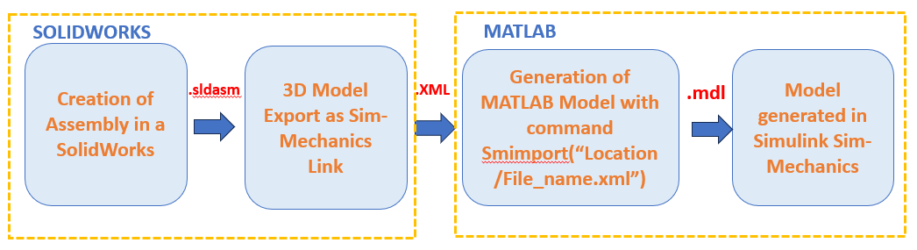
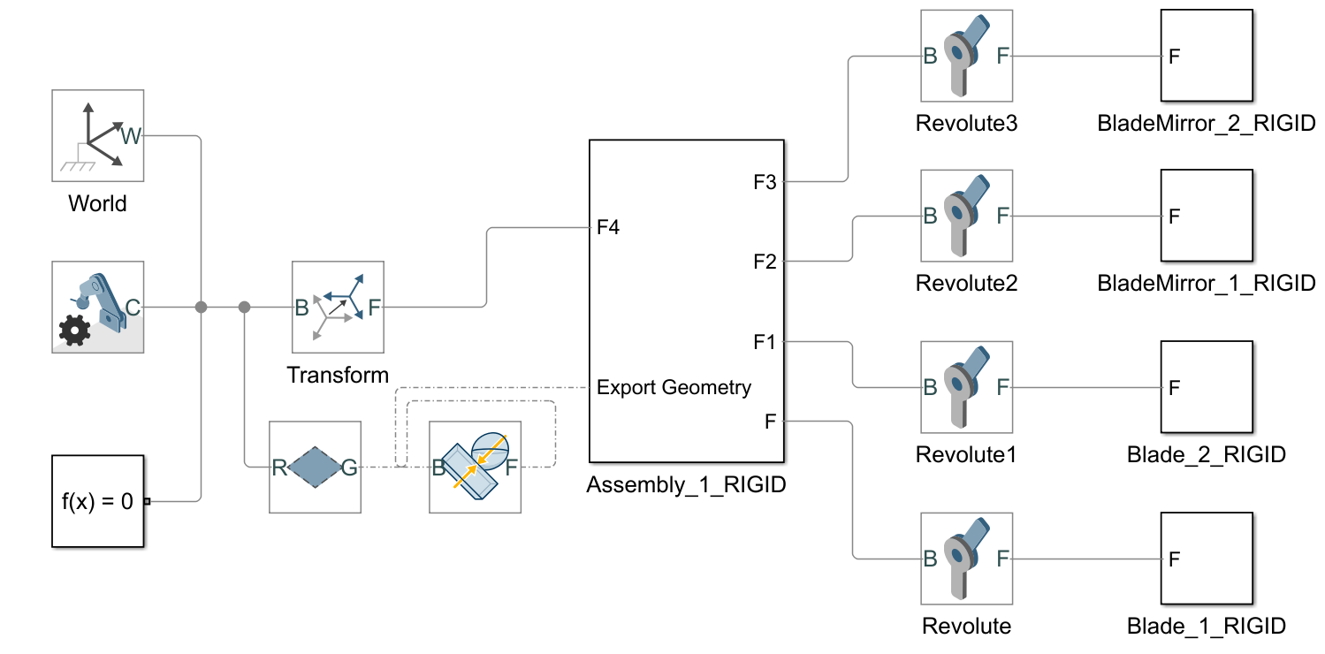
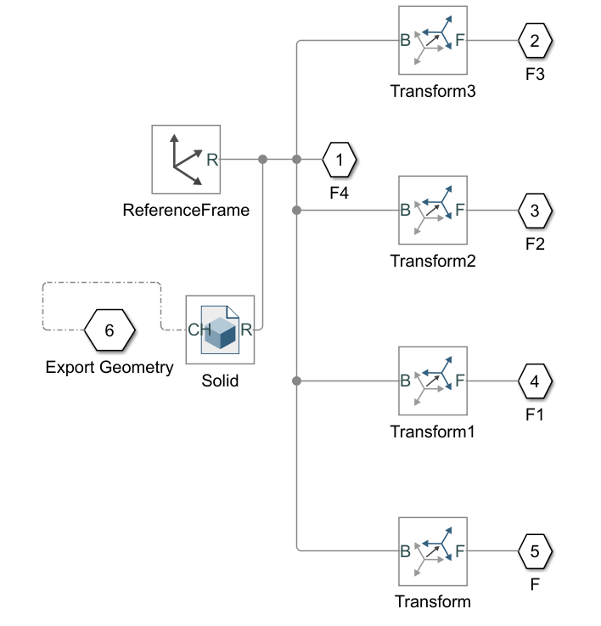
Simscape Model of Drone

Slide 13
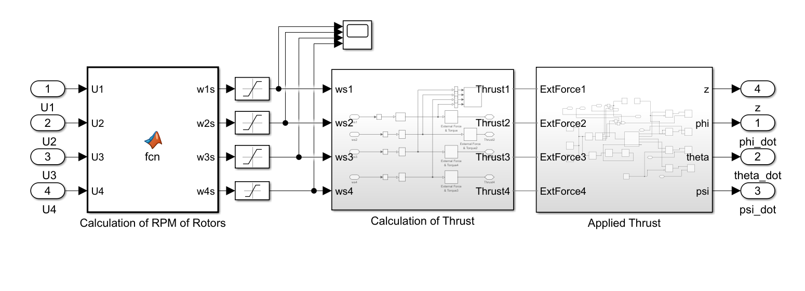
Dynamic Model in Simscape

Slide 14
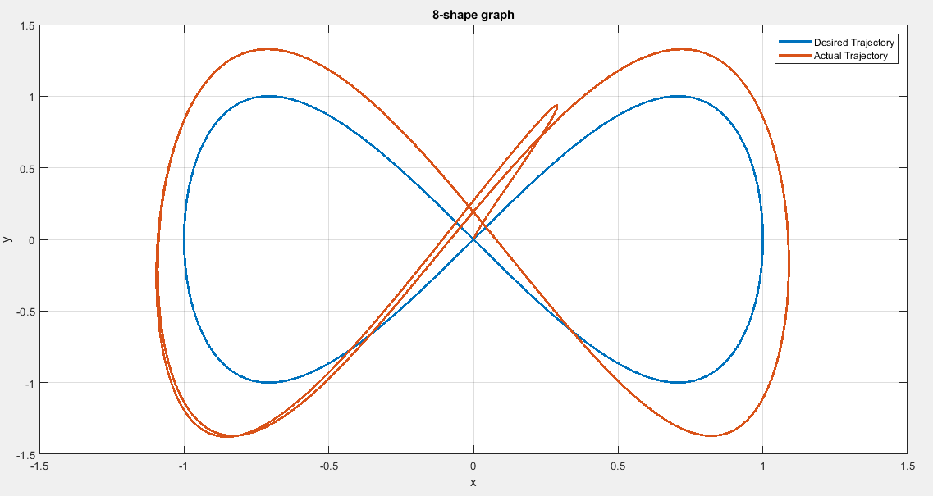
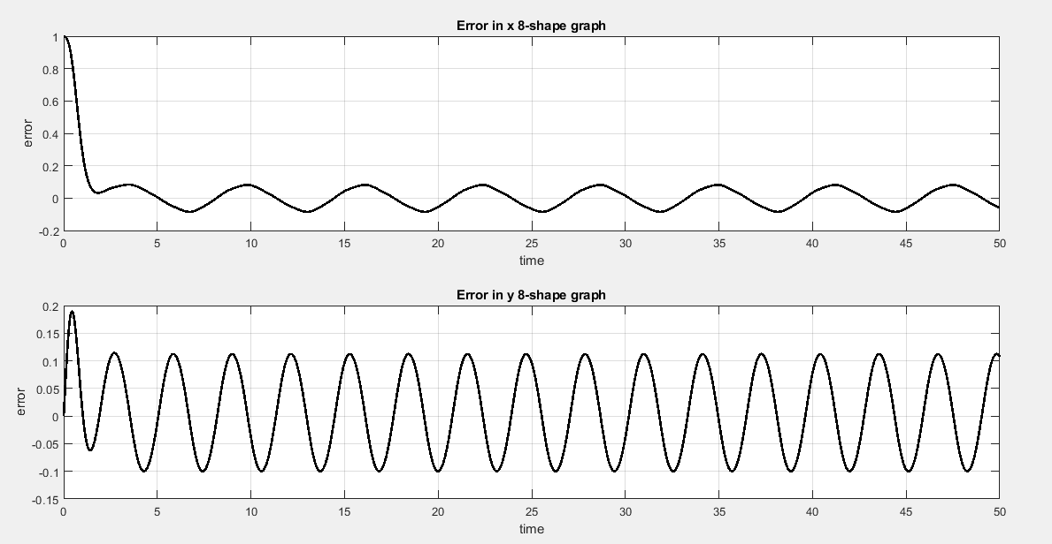
Result for Path Tracing
Desired vs Actual Trajectory
Error in X and Y

Slide 15
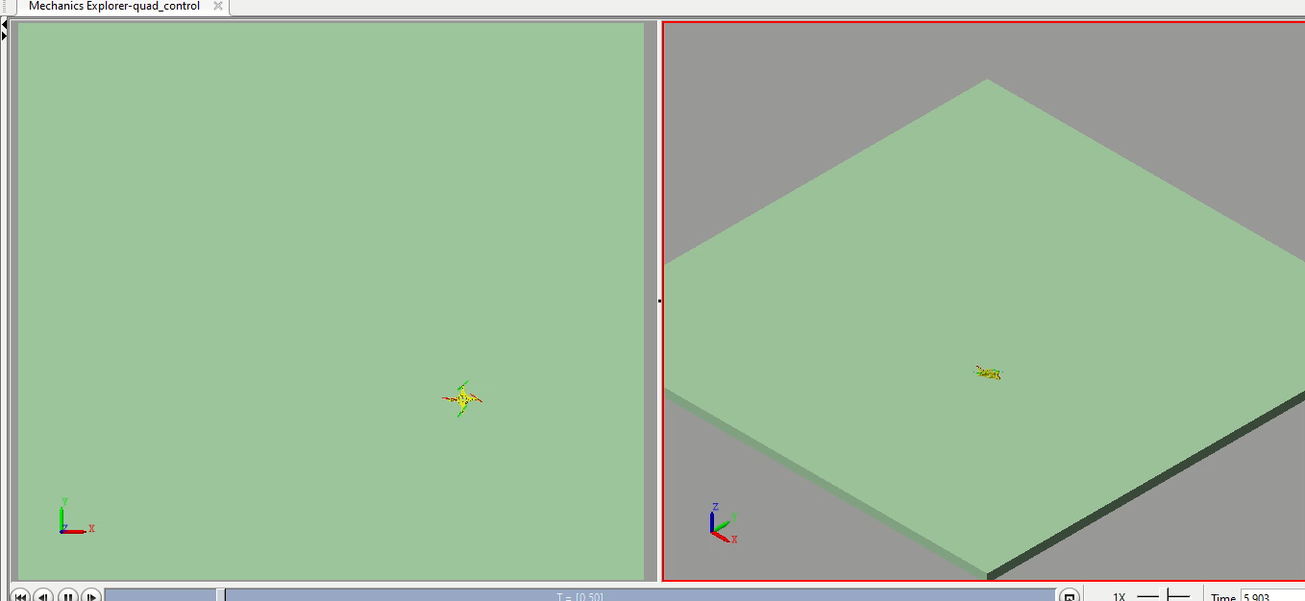
8 Shape Tracking Video

Slide 16
Challenges
Tuning Controllers: Challenges in tuning controllers for unpredictable conditions and uncertainties.
Chattering Reduction in SMC: Mitigating chattering effects in Sliding Mode Control for smoother drone control.
Nonlinear System Dynamics: Coping with complex nonlinear dynamics in amphibious drone systems.
Simscape Model Creation: Creating accurate drone models in Simscape poses challenges.
Non-real Sensor Readings: Dealing with non-realistic readings from sensors during development.
Complex Mathematical Models: Developing intricate mathematical models for highly complex amphibious drone systems.

Slide 17
Future Work
We can implement more advanced control systems like event triggering, Neural Networks, and Path Planning.
2. We have implemented different controllers for the aerial environment, which can
be extended to the underwater environment so that we can make UAUVs.
3. Implementation of these controllers in Physical Model

Slide 18
Reference
Quadrotor Attitude Control Based on Fuzzy Sliding Mode Control Theory
https://ieeexplore.ieee.org/stamp/stamp.jsp?tp=&arnumber=8865754
2. A Review of Control Algo for Quadrotor
https://ieeexplore.ieee.org/stamp/stamp.jsp?tp=&arnumber=8812437
3. A Review of Quadrotor Unmanned Aerial Vehicles: Applications, Architectural Design and Control Algorithms
https://doi.org/10.1007/s10846-021-01527-7
4. Modelling and Robust Control of Hybrid Unmanned Aerial-Underwater Robot in the Presence of Uncertainty
https://doi.org/10.1145/3610419.3610463
5. Fuzzy sliding-mode control of structures
https://www.sciencedirect.com/science/article/pii/S0141029604003396?via%3Dihub
6. Adaptive Sliding Mode Control for Quadrotor Attitude Stabilization and Altitude Tracking
https://ieeexplore.ieee.org/stamp/stamp.jsp?tp=&arnumber=6108547
7. https://andrew.gibiansky.com/blog/physics/quadcopter-dynamics/

Slide 19

Thank
You!

